Slide 1
Project Report on OSDA Yuan Wei
Faculty of Computer Science
Data Science
Project Based on Titanic Survivor Predictions

Slide 2
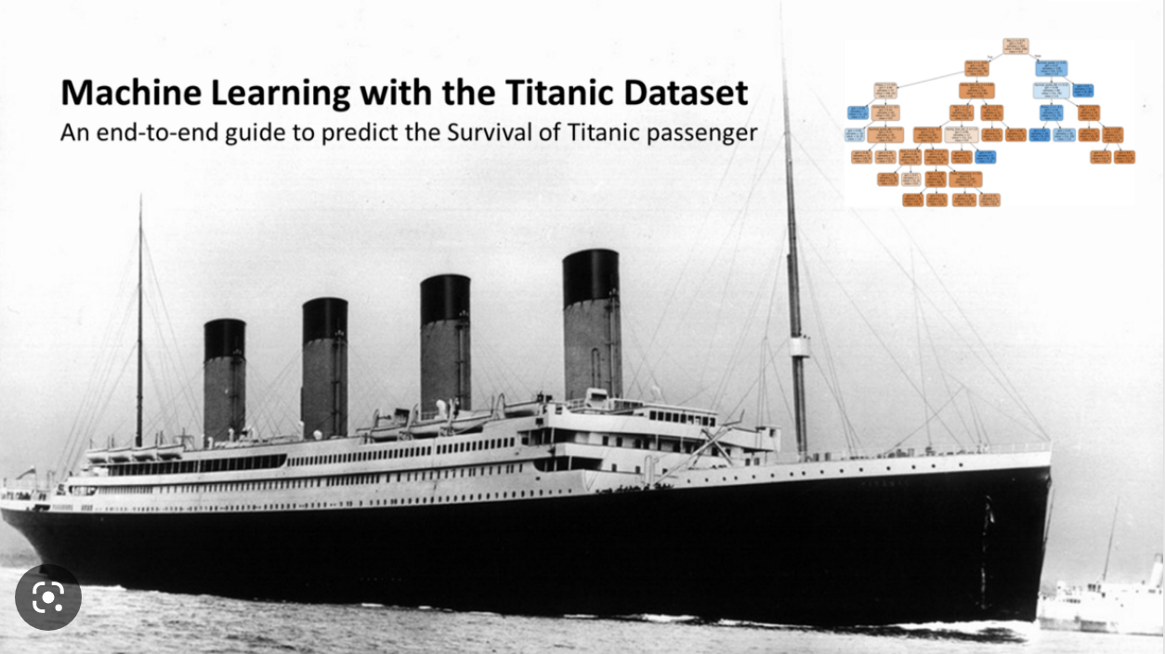
Background
Overview
Titanic: An Olympic-class liner of the British White Star Line, construction began on 31 March 1909 at the Harland & Wolff shipyard in Belfast Harbour, Ireland, was launched on 31 May 1911 and completed for sea trials on 2 April 1912.
First voyage: 10 April 1912
Route: From Southampton, England, via Cherbourg-Octeville, France, and Queenstown, Ireland, to New York, USA.
Shipwreck: 15 April 1912 (hit an iceberg at around 2340 hours on 14 April 1912)
Number of crew + passengers: 2224
Number of people killed: 1502 (67.5%)

Slide 3
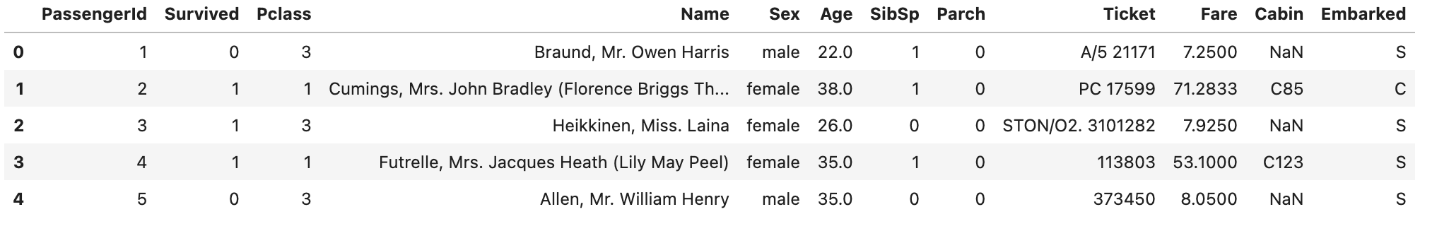
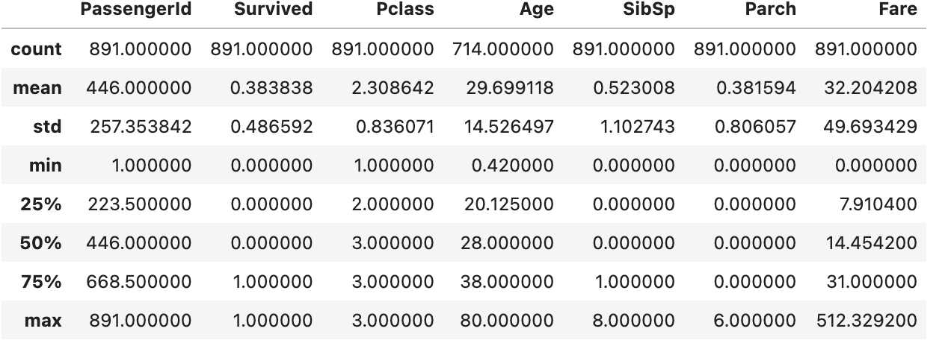
Dataset overview
Overview
Passenger ID
Survived:
Survived(1)-38% Dead(2)-62%
Pclass:
1=advanced, 2=intermediate, 3=low
Name
Sex
Age:missing 20% data
Sibsp
Ticket number
Fare
Cabin number
Embarked Port of embarkation

Slide 4
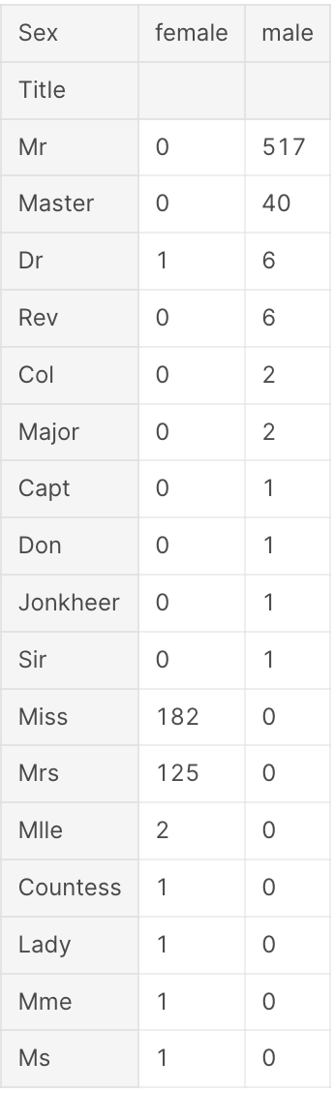
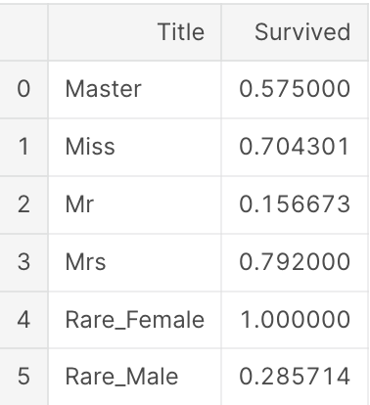
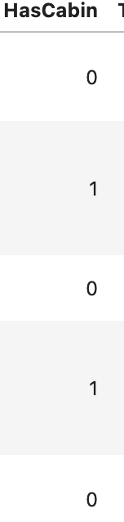
Feature Extraction
Name -> Title
Cabin-> Has or no
Ticket -> removal

Slide 5
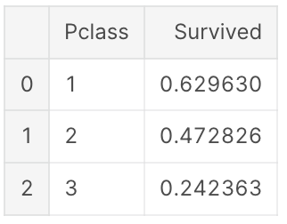
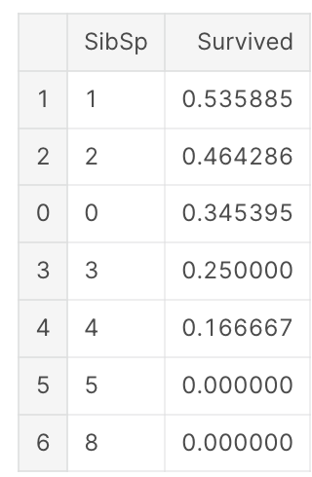
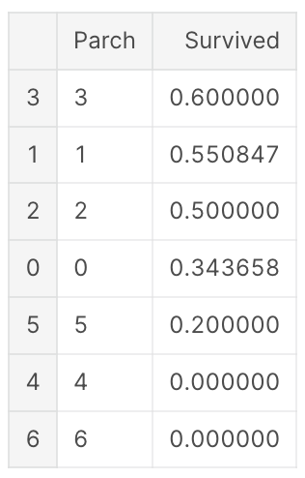
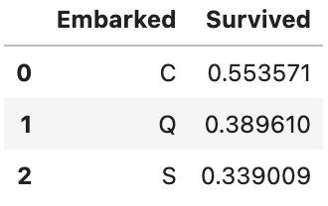
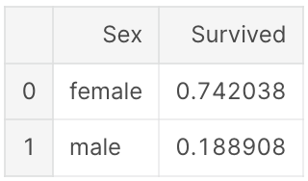
Feature Extraction
Correlation of several enumerated features with Survived Aggregation for mean value

Slide 6
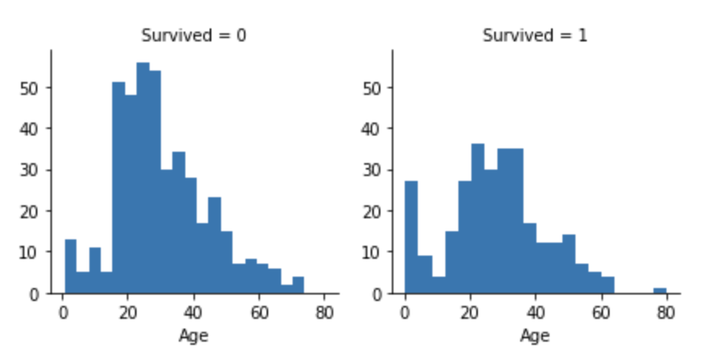
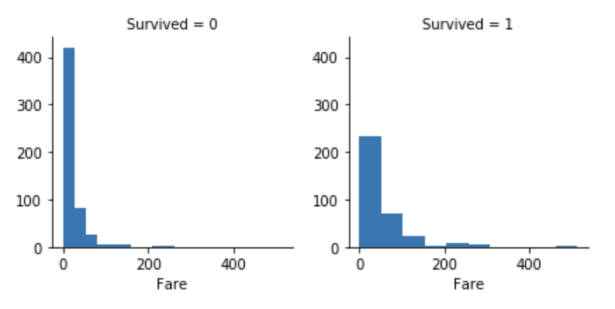
Correlation of several enumerated features with Survived View through histogram
Feature Extraction
Histograms are used for long span characteristics such as age to see the distribution of survivors and non-survivors separately

Slide 7
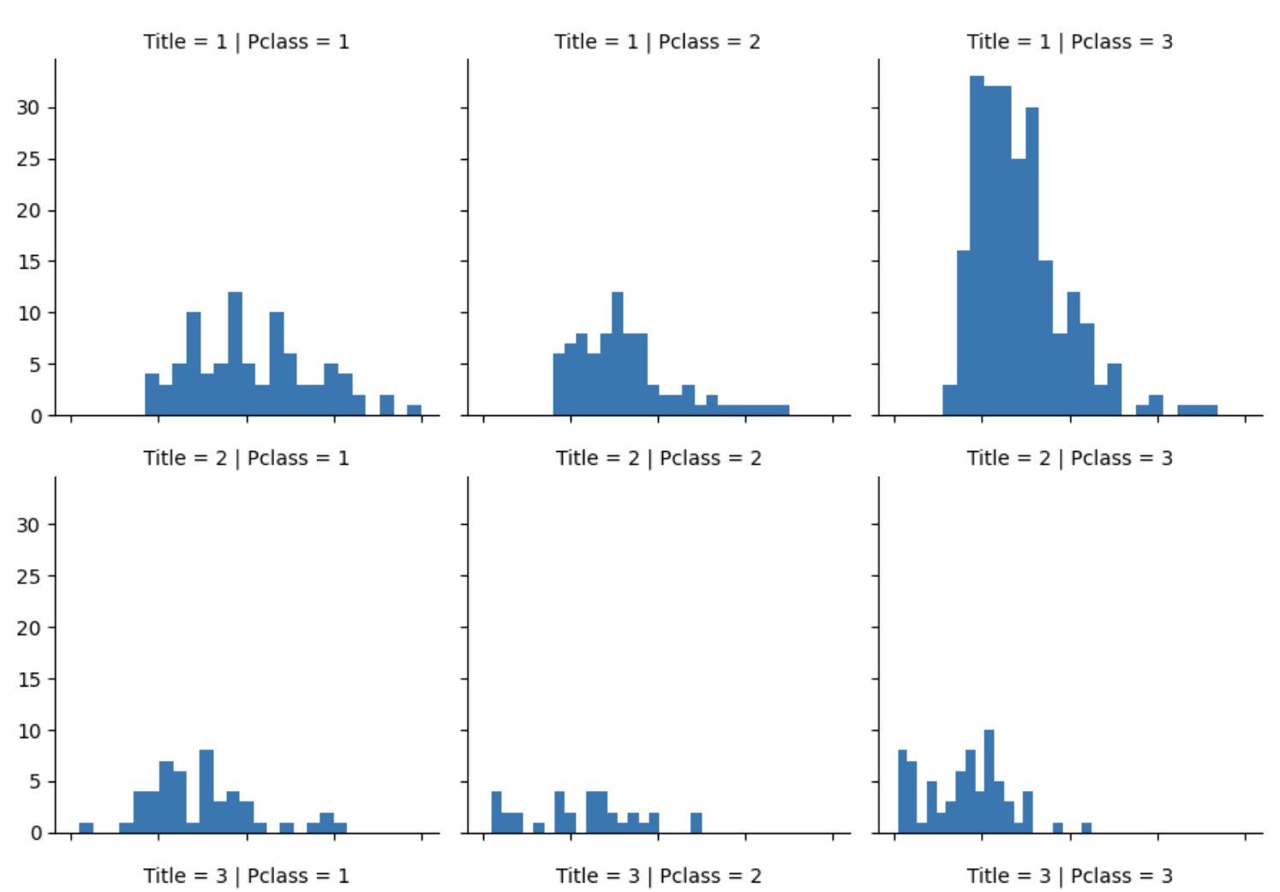
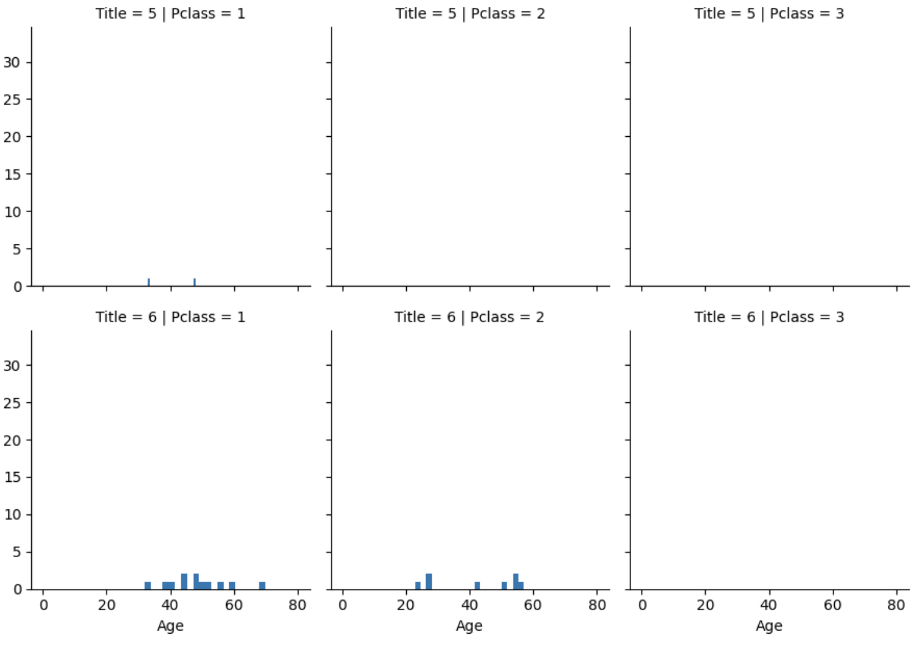
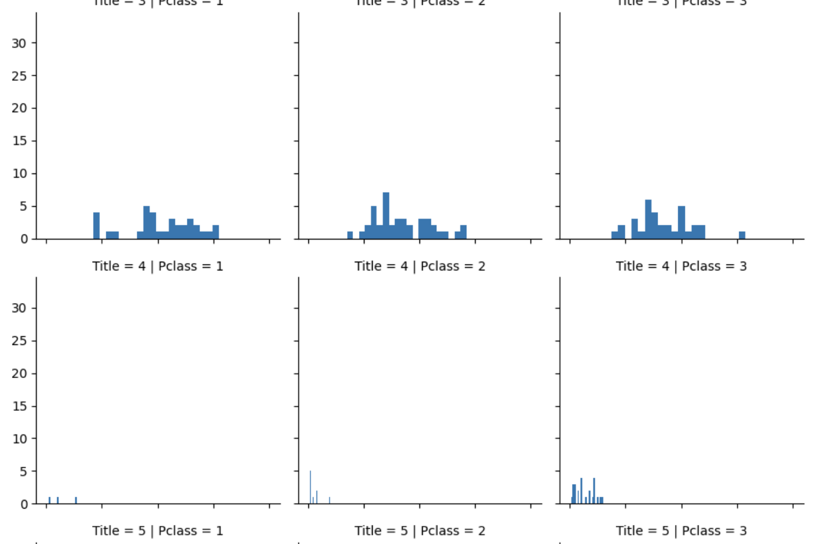
Feature Extraction
Age -> Fix missing values
Predictive supplementation for null values in the Age field
Take the median age of the same Pclass and Title for supplementation (Here for Pclass and Sex)

Slide 8
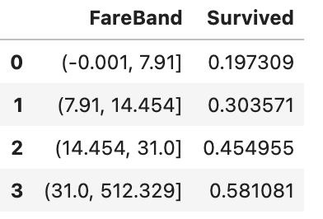
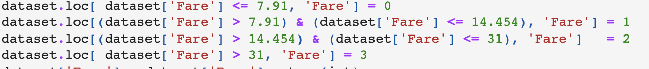
Feature Extraction
Create FareBand interval features
Convert Fare features to ordinal values based on FareBand

Slide 9
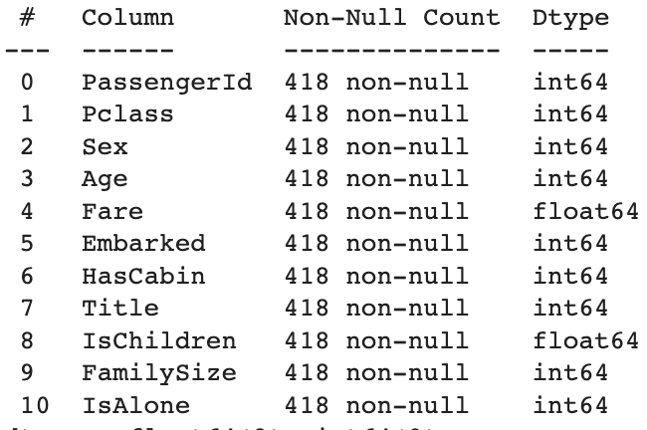
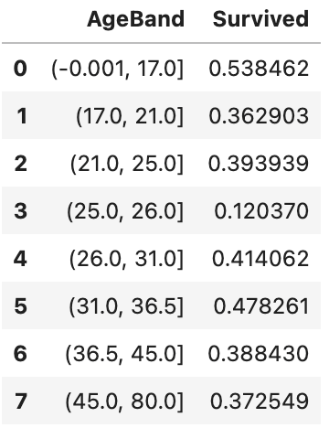
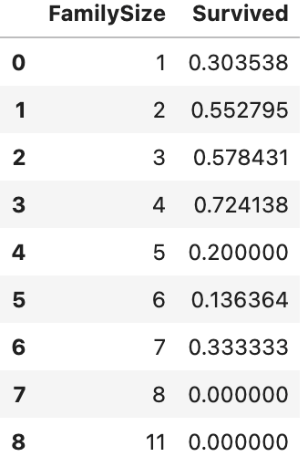
Adding new features
Feature Extraction
First we check if the passenger is child
Second we classify people with different ages
First we check if the passenger is alone
Second we classify people with different family sizes

Slide 10
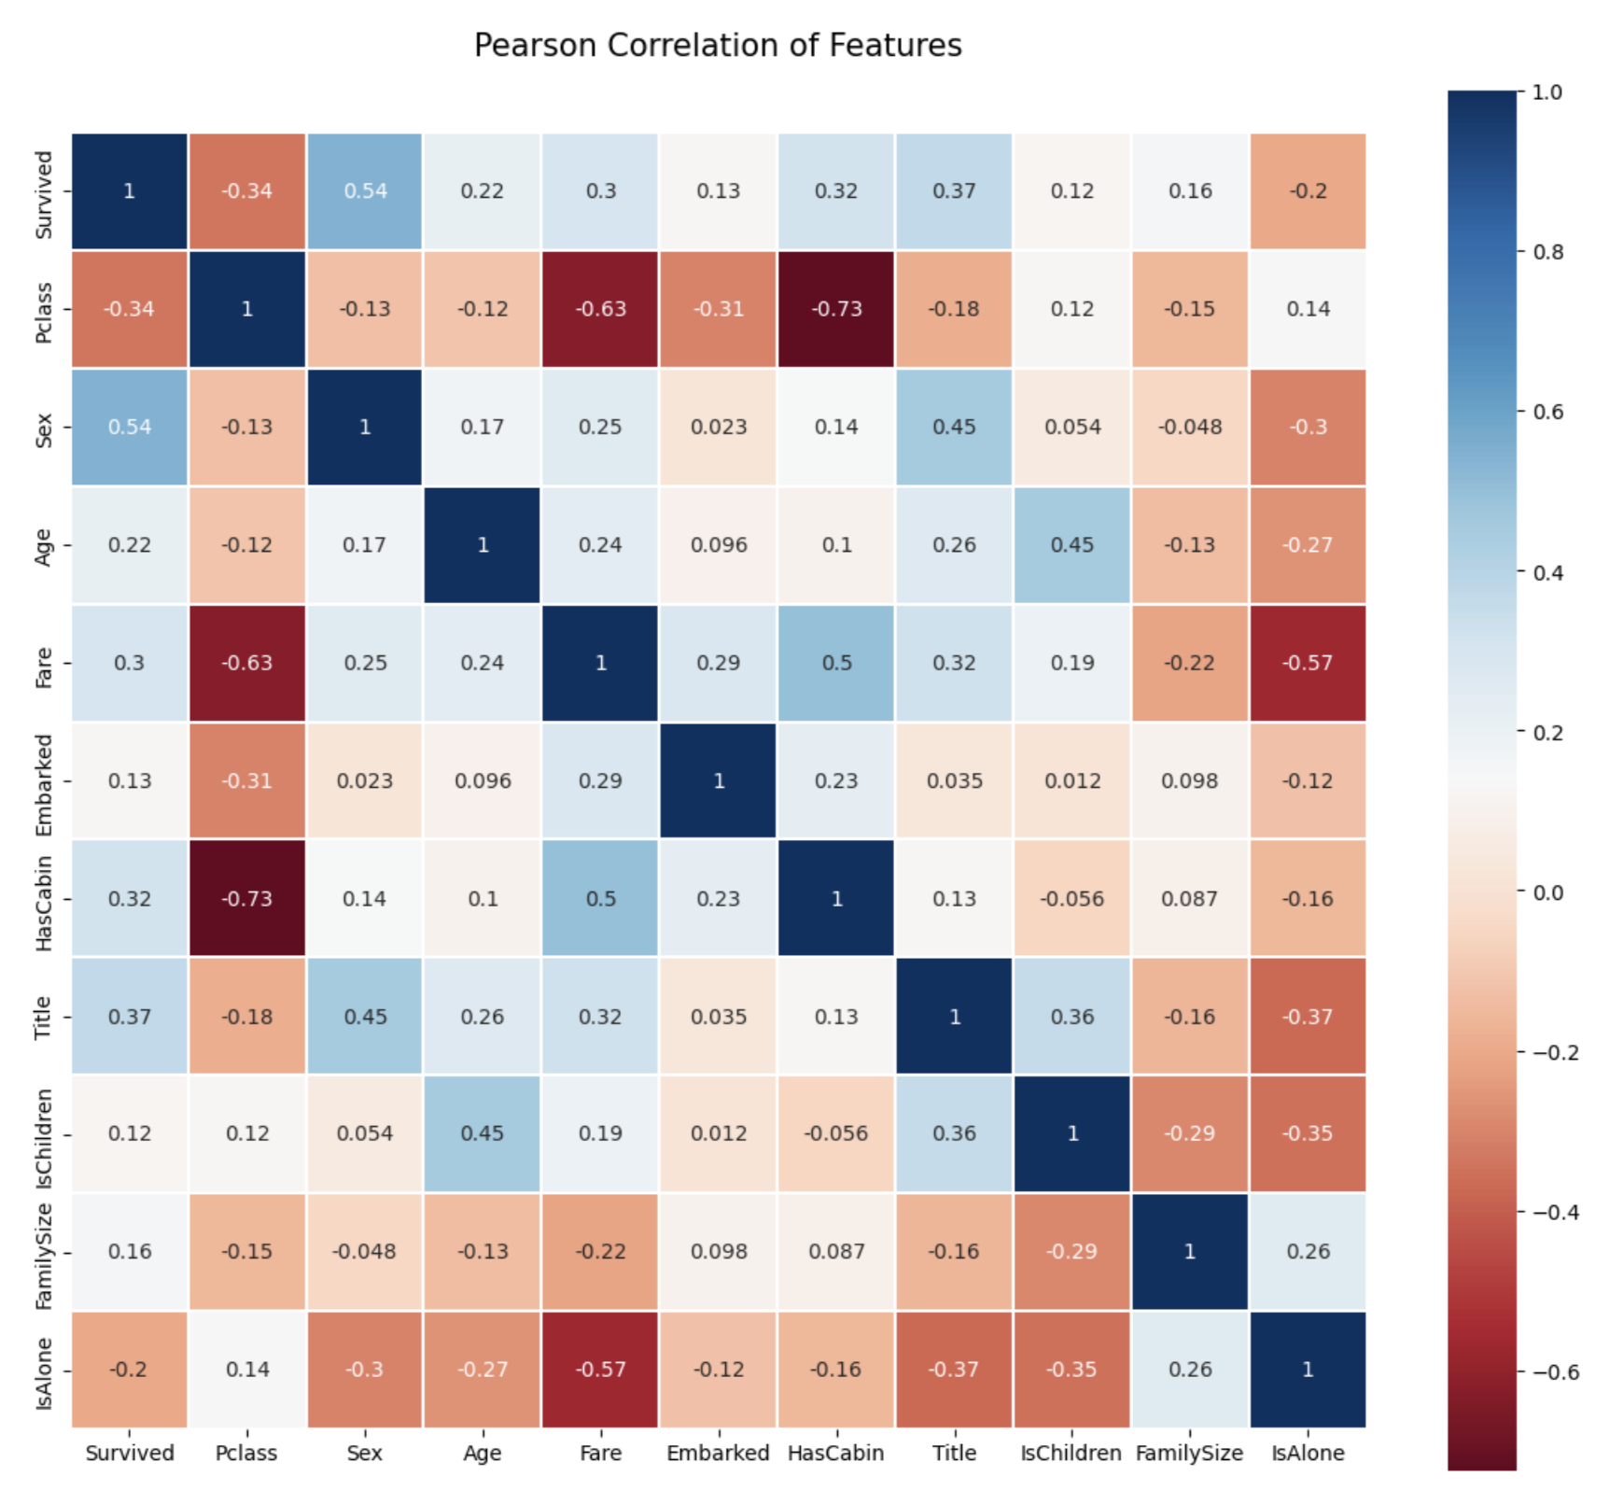
Feature correlation visualization Visualize correlations between features using seaborn's heatmap
Feature Extraction

Slide 11
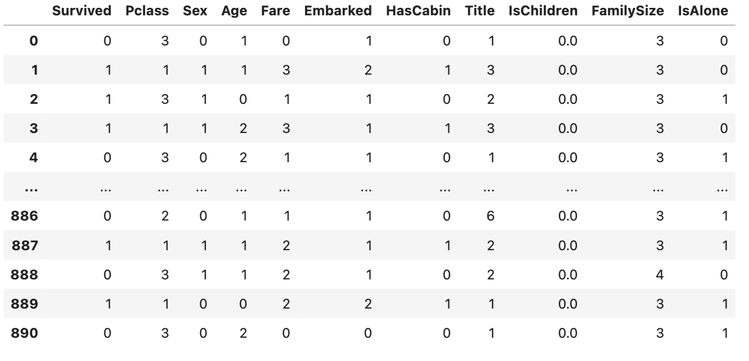
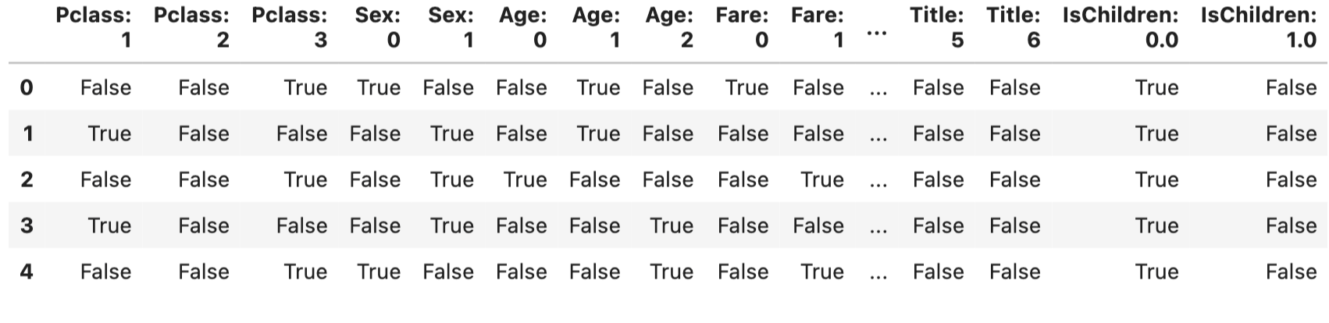
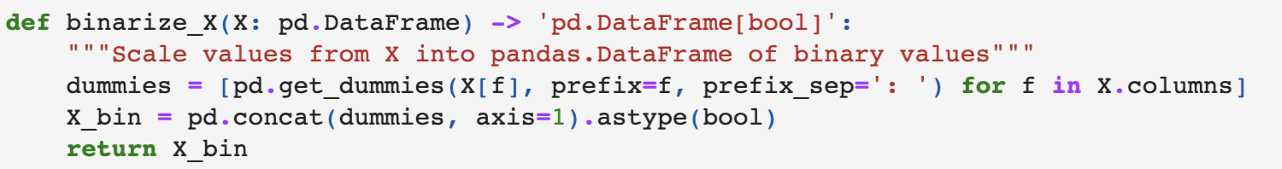
Binarization
Binarization
As we obtain the new dataset with 11 features, it's easy to apply the proposed algorithm to binarize.
After binarization,we get dataset with 31 columns which is quite reasonable
Binarization logic:

Slide 12
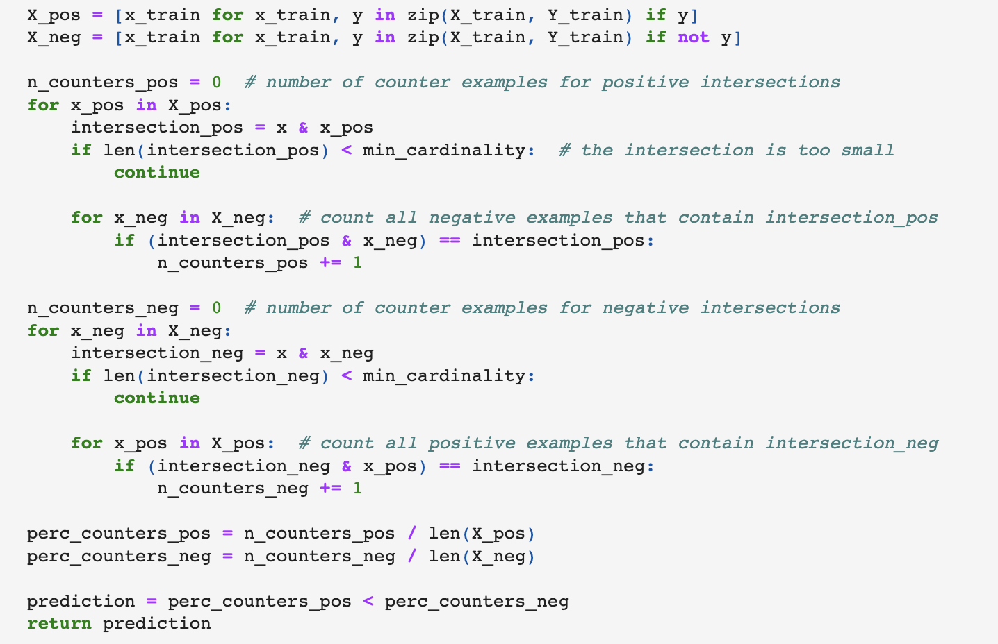
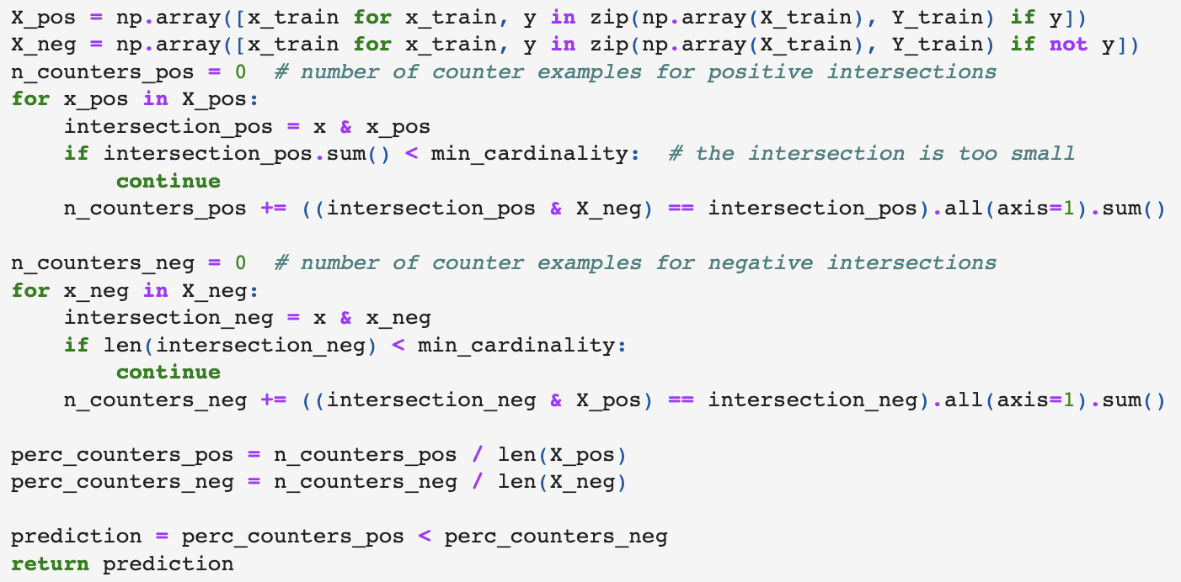
Baseline Algorithm
Data Processing
Rewrite Baseline Algorithm with Numpy

Slide 13
Comparison
Results
Model | Running Time | Accuracy | Precision | Recall
LazyFCA | 20s | 75.71 | 0.81 | 0.49
LazyFCA with Numpy | 11.3s | 75.64 | 0.81 | 0.49

Slide 14
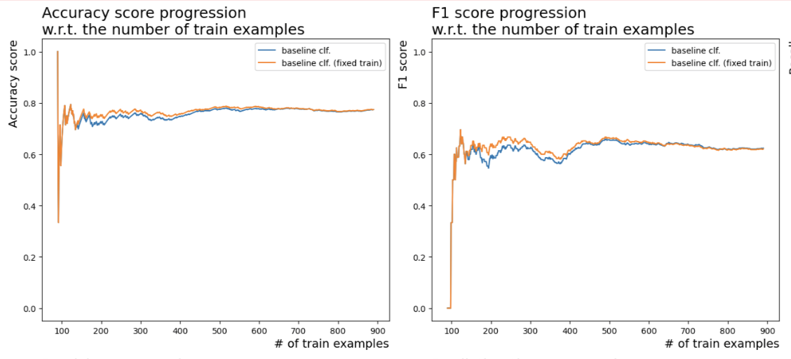
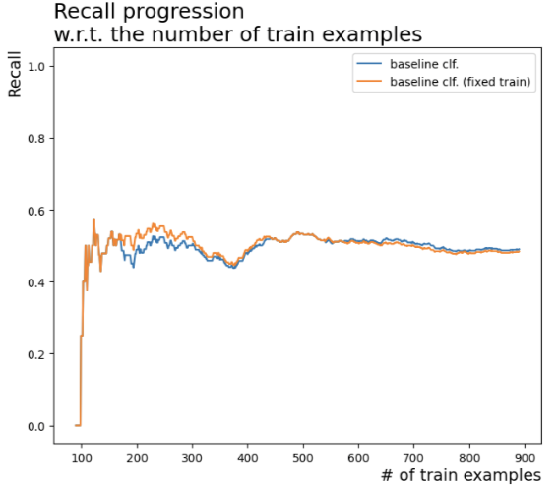
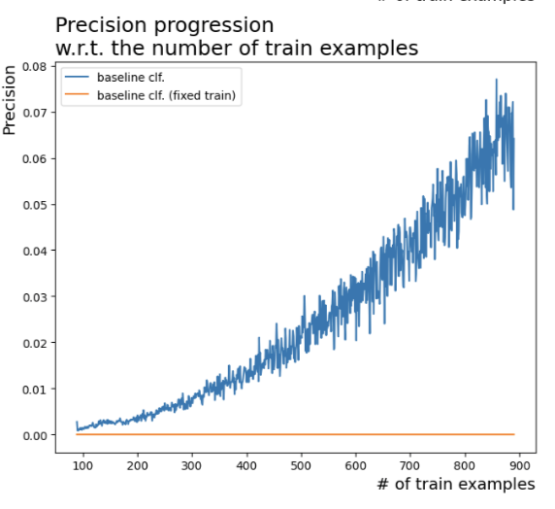
Results from LazyFCA
Results

Slide 15
Results
Comparison
Model | Accuracy | Precision | Recall
LazyFCA | 79.05 | 0.82 | 0.49
Logistic Regression | 82.15 | 0.76 | 0.70
Support Vector Machine | 83.28 | 0.81 | 0.72
KNN | 85.30 | 0.81 | 0.67
Decision Tree | 88.78 | 0.79 | 0.69
Random Forest | 83.15 | 0.80 | 0.71

Slide 16
Conclusion
Conclusion
It is easy to see from the above that the rewritten code clearly outperforms the original algorithm in terms of running speed. However, since the core logic has not changed, there is hardly any difference in prediction accuracy.
In comparison with the existing mainstream algorithms, lazyfca does not have a clear advantage and is far below the mainstream algorithms in terms of recall.
Decision trees clearly outperform other algorithms in predicting the dataset used in this task, while the simplest KNN also performs similarly to decision trees
If we take into account that this dataset is inherently unbalanced and we do not consider accuracy, then the support vector machine and random forest perform best.

Slide 17
Thank you!

